Slide 1
The LukeMain.com Lockdown Quiz 3
Introduction
Logos
Rhyme Time
Flags
High-Low
Numbers
Wipeout
Auto-play version
Start Slide Show (press F5) then click (or press space/right arrow key) to start the quiz
Following slides will advance automatically on a timer
Click to pause any auto slides

Slide 2
Introduction
Logos
Rhyme Time
Flags
High-Low
Numbers
Wipeout
Rounds
Logos
Rhyme Time
Flags
Highbrow Lowbrow
Numbers
Wipeout
The egg timer will count down the time until the next screen →
and turn red for the last 5 seconds

Slide 3
Logos
Introduction
Logos
Rhyme Time
Flags
High-Low
Numbers
Wipeout
Name the brand from the pictures
1 point for each
Questions: 12 Total Points: 12

Slide 4












Introduction
Logos
Rhyme Time
Flags
High-Low
Numbers
Wipeout
1.
2.
3.
4.
5.
6.
7.
8.
9.
10.
11.
12.

Slide 5
Logos Answers
Introduction
Logos
Rhyme Time
Flags
High-Low
Numbers
Wipeout
Name the brand from the pictures
1 point for each
Questions: 12 Total Points: 12

Slide 6
Introduction
Logos
Rhyme Time
Flags
High-Low
Numbers
Wipeout
1. Netflix
2. Puma
3. Kellogg’s
4. Esso
5. MasterChef
6. Airbnb
7. Lidl
8. Nando’s
9. LG
10. Coca-Cola
11. Vodafone
12. Motorola

Slide 7
Rhyme Time
Introduction
Logos
Rhyme Time
Flags
High-Low
Numbers
Wipeout
The answers in each question rhyme with each other
1 point for both correct answers
Questions: 8 Total Points: 8

Slide 8
Rhyme Time
Introduction
Logos
Rhyme Time
Flags
High-Low
Numbers
Wipeout
1.
Original Tibetan name for the Abominable Snowman
Long thin cylindrical pasta

Slide 9
Rhyme Time
Introduction
Logos
Rhyme Time
Flags
High-Low
Numbers
Wipeout
2.
Type of bird known for their drumming
Birthplace of Muhammed

Slide 10
Rhyme Time
Introduction
Logos
Rhyme Time
Flags
High-Low
Numbers
Wipeout
3.
Yogi Bear’s constant companion
Teletubbies vacuum cleaner

Slide 11
Rhyme Time
Introduction
Logos
Rhyme Time
Flags
High-Low
Numbers
Wipeout
4.
Most populous city in Japan
Disney’s second animated feature film

Slide 12
Rhyme Time
Introduction
Logos
Rhyme Time
Flags
High-Low
Numbers
Wipeout
5.
First name of actor Gooding Jr. of A Few Good Men and Rat Race
Lowest-pitched brass instrument

Slide 13
Rhyme Time
Introduction
Logos
Rhyme Time
Flags
High-Low
Numbers
Wipeout
6.
The Komodo dragon is the largest type of what?
Glam rock band formed by Roy Wood, famous for a Christmas song

Slide 14
Rhyme Time
Introduction
Logos
Rhyme Time
Flags
High-Low
Numbers
Wipeout
7.
Personification of death
Singer with 2017 UK number 1 singles ‘New Rules’ and ‘One Kiss’

Slide 15
Rhyme Time
Introduction
Logos
Rhyme Time
Flags
High-Low
Numbers
Wipeout
8.
Music genre stemming from UK garage, jungle and hip hop
Fourth herb in title of Simon & Garfunkel’s third studio album

Slide 16
Rhyme Time Answers
Introduction
Logos
Rhyme Time
Flags
High-Low
Numbers
Wipeout
The answers in each question rhyme with each other
1 point for both correct answers
Questions: 8 Total Points: 8

Slide 17
Rhyme Time Answers
Introduction
Logos
Rhyme Time
Flags
High-Low
Numbers
Wipeout
Yeti
Spaghetti
1.
Original Tibetan name for the Abominable Snowman
Long thin cylindrical pasta

Slide 18
Rhyme Time Answers
Introduction
Logos
Rhyme Time
Flags
High-Low
Numbers
Wipeout
Woodpecker
Mecca
2.
Type of bird known for their drumming
Birthplace of Muhammed

Slide 19
Rhyme Time Answers
Introduction
Logos
Rhyme Time
Flags
High-Low
Numbers
Wipeout
Boo-Boo
Noo-Noo
3.
Yogi Bear’s constant companion
Teletubbies vacuum cleaner

Slide 20
Rhyme Time Answers
Introduction
Logos
Rhyme Time
Flags
High-Low
Numbers
Wipeout
Tokyo
Pinocchio
4.
Most populous city in Japan
Disney’s second animated feature film

Slide 21
Rhyme Time Answers
Introduction
Logos
Rhyme Time
Flags
High-Low
Numbers
Wipeout
Cuba
Tuba
5.
First name of actor Gooding Jr. of A Few Good Men and Rat Race
Lowest-pitched brass instrument

Slide 22
Rhyme Time Answers
Introduction
Logos
Rhyme Time
Flags
High-Low
Numbers
Wipeout
Lizard
Wizzard
6.
The Komodo dragon is the largest type of what?
Glam rock band formed by Roy Wood, famous for a Christmas song

Slide 23
Rhyme Time Answers
Introduction
Logos
Rhyme Time
Flags
High-Low
Numbers
Wipeout
Grim Reaper
Dua Lipa
7.
Personification of death
Singer with 2017 UK number 1 singles ‘New Rules’ and ‘One Kiss’

Slide 24
Rhyme Time Answers
Introduction
Logos
Rhyme Time
Flags
High-Low
Numbers
Wipeout
Grime
Thyme
8.
Music genre stemming from UK garage, jungle and hip hop
Fourth herb in title of Simon & Garfunkel’s third studio album

Slide 25
Flags
Introduction
Logos
Rhyme Time
Flags
High-Low
Numbers
Wipeout
Pick the flag that matches the country
1 point for the correct answer
Questions: 10 Total Points: 10

Slide 26

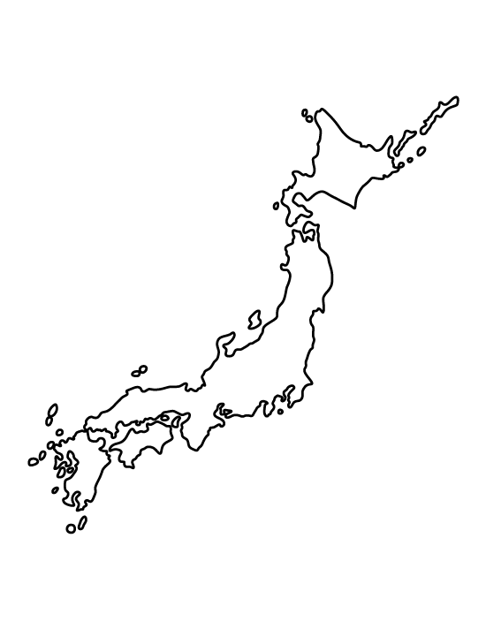


Flags
Introduction
Logos
Rhyme Time
Flags
High-Low
Numbers
Wipeout
A
1.
B
C

Slide 27
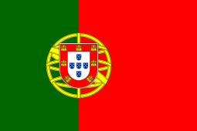
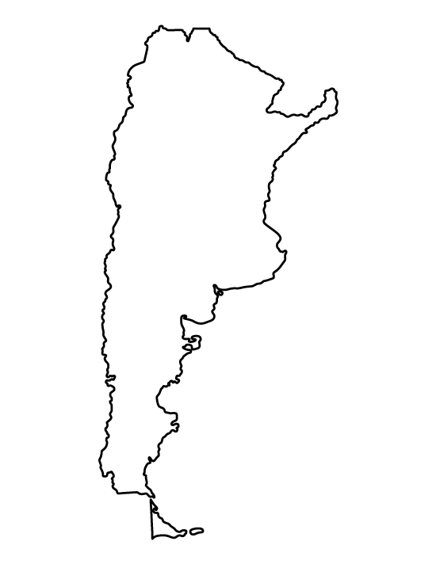


Flags
Introduction
Logos
Rhyme Time
Flags
High-Low
Numbers
Wipeout
A
2.
B
C

Slide 28

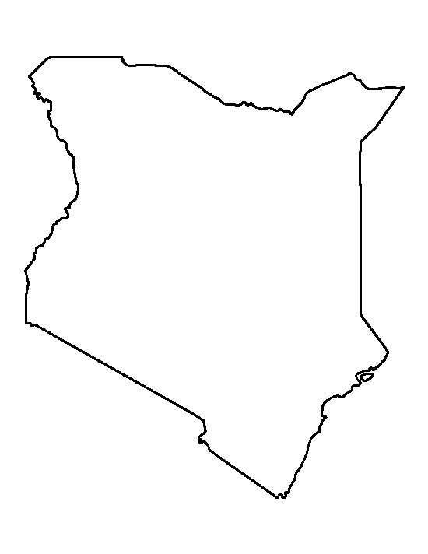


Flags
Introduction
Logos
Rhyme Time
Flags
High-Low
Numbers
Wipeout
A
3.
B
C

Slide 29

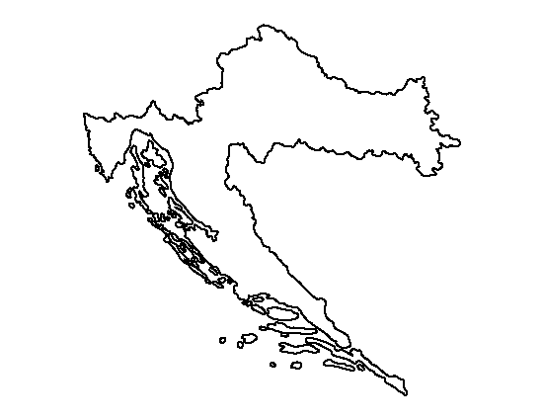
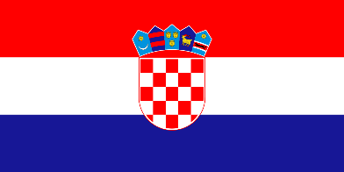

Flags
Introduction
Logos
Rhyme Time
Flags
High-Low
Numbers
Wipeout
A
4.
B
C

Slide 30

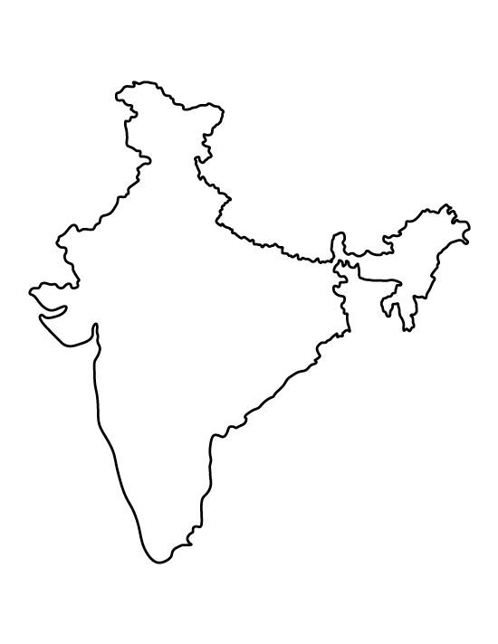


Flags
Introduction
Logos
Rhyme Time
Flags
High-Low
Numbers
Wipeout
A
5.
B
C

Slide 31

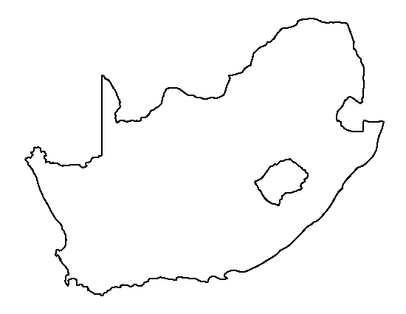


Flags
Introduction
Logos
Rhyme Time
Flags
High-Low
Numbers
Wipeout
A
6.
B
C

Slide 32

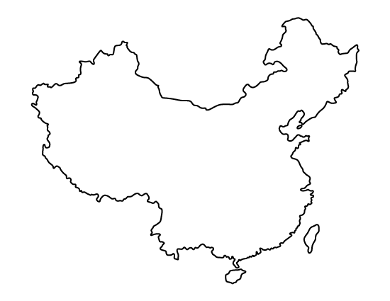


Flags
Introduction
Logos
Rhyme Time
Flags
High-Low
Numbers
Wipeout
A
7.
B
C

Slide 33

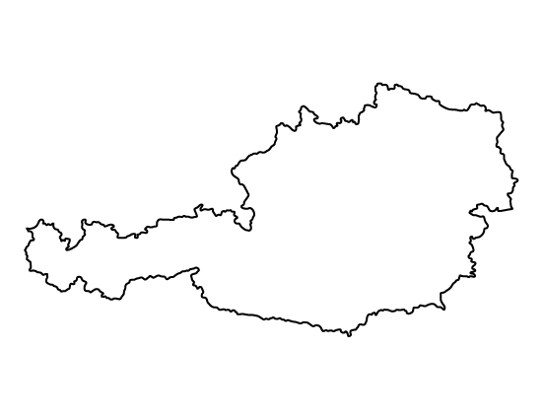


Flags
Introduction
Logos
Rhyme Time
Flags
High-Low
Numbers
Wipeout
A
8.
B
C

Slide 34
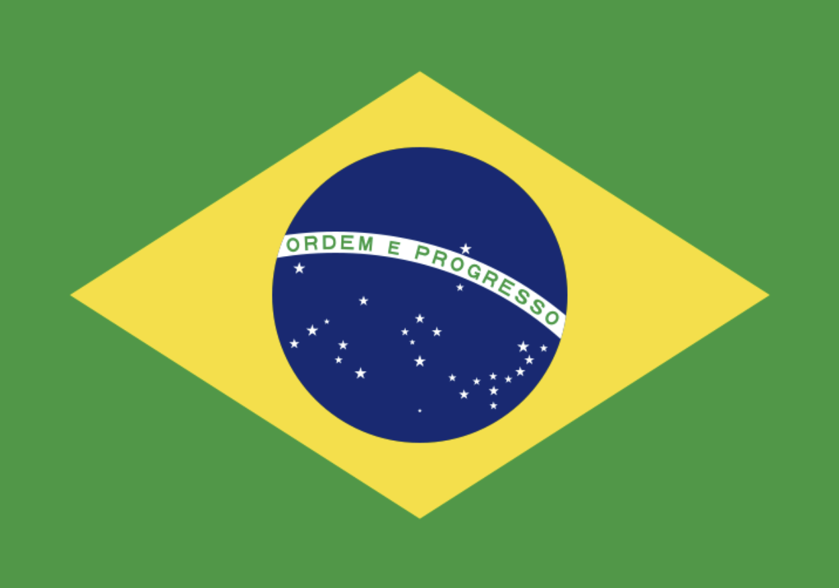
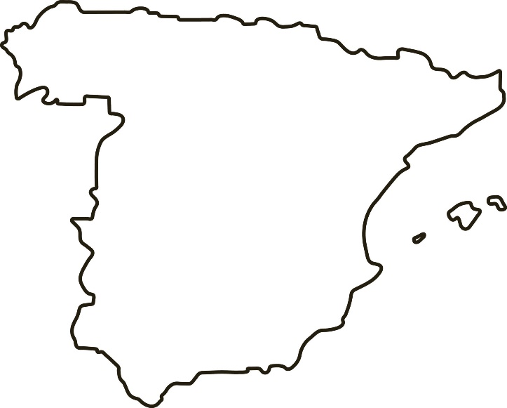
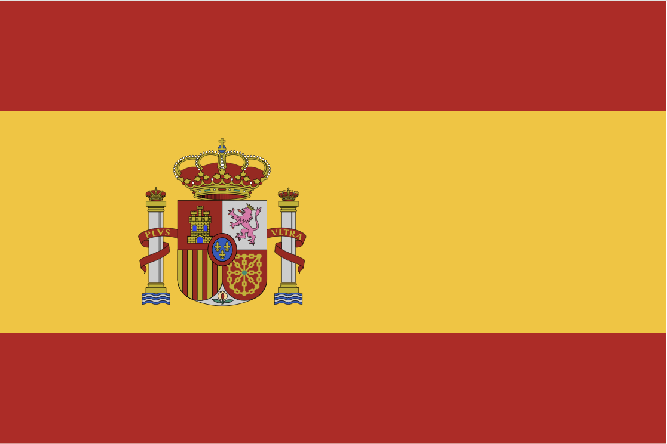

Flags
Introduction
Logos
Rhyme Time
Flags
High-Low
Numbers
Wipeout
A
9.
B
C

Slide 35

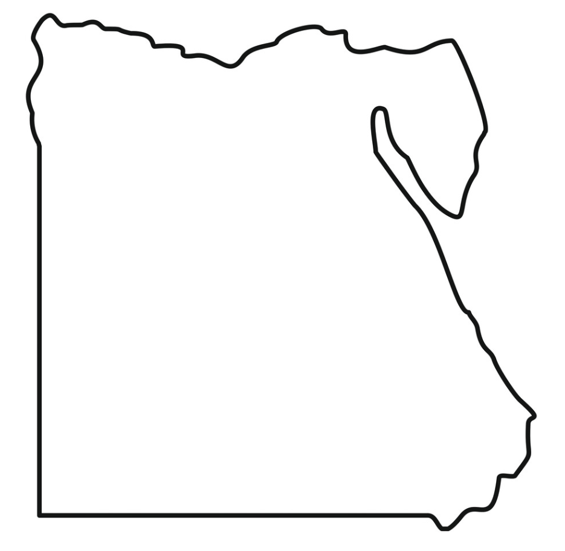

Flags
Introduction
Logos
Rhyme Time
Flags
High-Low
Numbers
Wipeout
A
10.
B
C

Slide 36
Flags Answers
Introduction
Logos
Rhyme Time
Flags
High-Low
Numbers
Wipeout
Pick the flag that matches the country
1 point for the correct answer
Total Points: 10

Slide 37
Flags Answers
Introduction
Logos
Rhyme Time
Flags
High-Low
Numbers
Wipeout
A
Japan
1.

Slide 38
Flags Answers
Introduction
Logos
Rhyme Time
Flags
High-Low
Numbers
Wipeout
2.
C
Argentina

Slide 39
Flags Answers
Introduction
Logos
Rhyme Time
Flags
High-Low
Numbers
Wipeout
3.
C
Kenya

Slide 40
Flags Answers
Introduction
Logos
Rhyme Time
Flags
High-Low
Numbers
Wipeout
4.
B
Croatia

Slide 41
Flags Answers
Introduction
Logos
Rhyme Time
Flags
High-Low
Numbers
Wipeout
5.
B
India

Slide 42
Flags Answers
Introduction
Logos
Rhyme Time
Flags
High-Low
Numbers
Wipeout
6.
C
South Africa

Slide 43
Flags Answers
Introduction
Logos
Rhyme Time
Flags
High-Low
Numbers
Wipeout
7.
B
China

Slide 44
Flags Answers
Introduction
Logos
Rhyme Time
Flags
High-Low
Numbers
Wipeout
A
Austria
8.

Slide 45
Flags Answers
Introduction
Logos
Rhyme Time
Flags
High-Low
Numbers
Wipeout
9.
B
Spain

Slide 46
Flags Answers
Introduction
Logos
Rhyme Time
Flags
High-Low
Numbers
Wipeout
10.
B
Egypt

Slide 47
Highbrow Lowbrow
Introduction
Logos
Rhyme Time
Flags
High-Low
Numbers
Wipeout
2 points for the correct answer after first clue
1 point for the correct answer after the second clue
Questions: 5 Total Points: 10

Slide 48
Highbrow Lowbrow
Introduction
Logos
Rhyme Time
Flags
High-Low
Numbers
Wipeout
1.
Boyko Borisov is the Prime Minister of…
Write down an answer before you see the second clue for a chance of 2 points

Slide 49
Highbrow Lowbrow
Introduction
Logos
Rhyme Time
Flags
High-Low
Numbers
Wipeout
1.
Boyko Borisov is the Prime Minister of…
The answer will be shown next so make sure you have something written down
The leader of the Wimbledon Wombles is Great Uncle…

Slide 50
Highbrow Lowbrow
Introduction
Logos
Rhyme Time
Flags
High-Low
Numbers
Wipeout
1.
Boyko Borisov is the Prime Minister of…
Bulgaria
The leader of the Wimbledon Wombles is Great Uncle…

Slide 51
Highbrow Lowbrow
Introduction
Logos
Rhyme Time
Flags
High-Low
Numbers
Wipeout
2.
The name of the rights read by an arresting officer in the United States
Write down an answer before you see the second clue for a chance of 2 points

Slide 52
Highbrow Lowbrow
Introduction
Logos
Rhyme Time
Flags
High-Low
Numbers
Wipeout
2.
The name of the rights read by an arresting officer in the United States
The answer will be shown next so make sure you have something written down
The title character of a BBC sitcom who lives in the flat above her joke shop

Slide 53
Highbrow Lowbrow
Introduction
Logos
Rhyme Time
Flags
High-Low
Numbers
Wipeout
2.
The name of the rights read by an arresting officer in the United States
Miranda
The title character of a BBC sitcom who lives in the flat above her joke shop

Slide 54
Highbrow Lowbrow
Introduction
Logos
Rhyme Time
Flags
High-Low
Numbers
Wipeout
3.
British Rock Band who had a hit with “Since You Been Gone” in 1979
Write down an answer before you see the second clue for a chance of 2 points

Slide 55
Highbrow Lowbrow
Introduction
Logos
Rhyme Time
Flags
High-Low
Numbers
Wipeout
3.
British Rock Band who had a hit with “Since You Been Gone” in 1979
The answer will be shown next so make sure you have something written down
Children’s TV series featuring Zippy, Bungle and George

Slide 56
Highbrow Lowbrow
Introduction
Logos
Rhyme Time
Flags
High-Low
Numbers
Wipeout
3.
British Rock Band who had a hit with “Since You Been Gone” in 1979
Rainbow
Children’s TV series featuring Zippy, Bungle and George

Slide 57
Highbrow Lowbrow
Introduction
Logos
Rhyme Time
Flags
High-Low
Numbers
Wipeout
4.
The Queen of Carthage in Virgil’s Aeneid
Write down an answer before you see the second clue for a chance of 2 points

Slide 58
Highbrow Lowbrow
Introduction
Logos
Rhyme Time
Flags
High-Low
Numbers
Wipeout
4.
The Queen of Carthage in Virgil’s Aeneid
The answer will be shown next so make sure you have something written down
British singer whose hits include “Thank You” and “White Flag”

Slide 59
Highbrow Lowbrow
Introduction
Logos
Rhyme Time
Flags
High-Low
Numbers
Wipeout
4.
The Queen of Carthage in Virgil’s Aeneid
Dido
British singer whose hits include “Thank You” and “White Flag”

Slide 60
Highbrow Lowbrow
Introduction
Logos
Rhyme Time
Flags
High-Low
Numbers
Wipeout
5.
Michelangelo’s 17 feet tall sculpture housed in the Galleria dell'Accademia in Florence
Write down an answer before you see the second clue for a chance of 2 points

Slide 61
Highbrow Lowbrow
Introduction
Logos
Rhyme Time
Flags
High-Low
Numbers
Wipeout
5.
Michelangelo’s 17 feet tall sculpture housed in the Galleria dell'Accademia in Florence
The answer will be shown next so make sure you have something written down
First name shared by actors Tennant, Schwimmer and Duchovny

Slide 62
Highbrow Lowbrow
Introduction
Logos
Rhyme Time
Flags
High-Low
Numbers
Wipeout
5.
Michelangelo’s 17 feet tall sculpture housed in the Galleria dell'Accademia in Florence
David
First name shared by actors Tennant, Schwimmer and Duchovny

Slide 63
Numbers
Introduction
Logos
Rhyme Time
Flags
High-Low
Numbers
Wipeout
Sort the 3 clues from lowest to highest value
2 points for the correct answer, e.g. B C A
Questions: 5 Total Points: 10

Slide 64
Numbers
Introduction
Logos
Rhyme Time
Flags
High-Low
Numbers
Wipeout
1.
A
B
C
Capsules on the London Eye
Letters in the Greek alphabet
Yards between cricket wickets

Slide 65
Numbers
Introduction
Logos
Rhyme Time
Flags
High-Low
Numbers
Wipeout
2.
A
B
C
Bones in the human body
Alan Shearer Premier League goals
Elements in the periodic table

Slide 66
Numbers
Introduction
Logos
Rhyme Time
Flags
High-Low
Numbers
Wipeout
3.
A
B
C
Total dots on a die
“The Lord is my shepherd” Psalm
Total balls on a snooker table

Slide 67
Numbers
Introduction
Logos
Rhyme Time
Flags
High-Low
Numbers
Wipeout
4.
A
B
C
Highest checkout in darts
CL in Roman numerals
In Monopoly, collect as you pass GO

Slide 68
Numbers
Introduction
Logos
Rhyme Time
Flags
High-Low
Numbers
Wipeout
5.
A
B
C
Basketball team members
Beach volleyball team members
University Challenge team members

Slide 69
Numbers Answers
Introduction
Logos
Rhyme Time
Flags
High-Low
Numbers
Wipeout
Sort the 3 clues from lowest to highest value
2 points for the correct answer, e.g. B C A
Questions: 5 Total Points: 10

Slide 70
Numbers Answers
Introduction
Logos
Rhyme Time
Flags
High-Low
Numbers
Wipeout
1.
C
B
A
22
24
32
Yards between cricket wickets
Letters in the Greek alphabet
Capsules on the London Eye

Slide 71
Numbers Answers
Introduction
Logos
Rhyme Time
Flags
High-Low
Numbers
Wipeout
2.
C
A
B
118
206
260
Elements in the periodic table
Bones in the human body
Alan Shearer Premier League goals

Slide 72
Numbers Answers
Introduction
Logos
Rhyme Time
Flags
High-Low
Numbers
Wipeout
3.
A
C
B
21
22
23
Total dots on a die
Total balls on a snooker table
“The Lord is my shepherd” Psalm

Slide 73
Numbers Answers
Introduction
Logos
Rhyme Time
Flags
High-Low
Numbers
Wipeout
4.
B
A
C
150
170
200
CL in Roman numerals
Highest checkout in darts
In Monopoly, collect as you pass GO

Slide 74
Numbers Answers
Introduction
Logos
Rhyme Time
Flags
High-Low
Numbers
Wipeout
5.
B
C
A
2
4
5
Beach volleyball team members
University Challenge team members
Basketball team members

Slide 75
Wipeout
Introduction
Logos
Answer Smash
Music Geography
High-Low
Celebrities
Wipeout
Write down one answer to the category
2 points if answer is correct and unique (no one else wrote it down)
Questions: 5 Total Points: 10

Slide 76
Wipeout
Introduction
Logos
Answer Smash
Music Geography
High-Low
Celebrities
Wipeout
1.
Surname of US President in the 20th Century (1900s)

Slide 77
Wipeout
Introduction
Logos
Answer Smash
Music Geography
High-Low
Celebrities
Wipeout
1.
Surname of US President in the 20th Century (1900s)
Time’s up!
Each player/team should now reveal their answer to the group
Any duplicates score zero points
Correct answers shown next…

Slide 78
Wipeout
Introduction
Logos
Answer Smash
Music Geography
High-Low
Celebrities
Wipeout
1.
Surname of US President in the 20th Century (1900s)
Bush
Carter
Clinton
Coolidge
Eisenhower
Ford
Harding
Hoover
Johnson
Kennedy
McKinley
Nixon
Reagan
Roosevelt
Taft
Truman
Wilson
2 points if answer is correct and unique

Slide 79
Wipeout
Introduction
Logos
Answer Smash
Music Geography
High-Low
Celebrities
Wipeout
2.
Football club in the Women’s Super League 2019-20 Season
Hint: they all share their name with a mens club

Slide 80
Wipeout
Introduction
Logos
Answer Smash
Music Geography
High-Low
Celebrities
Wipeout
2.
Football club in the Women’s Super League 2019-20 Season
Time’s up!
Each player/team should now reveal their answer to the group
Any duplicates score zero points
Correct answers shown next…

Slide 81
Wipeout
Introduction
Logos
Answer Smash
Music Geography
High-Low
Celebrities
Wipeout
2.
Football club in the Women’s Super League 2019-20 Season
Arsenal
Birmingham City
Brighton & Hove Albion
Bristol City
Chelsea
Everton
Liverpool
Manchester City
Manchester United
Reading
Tottenham Hotspur
West Ham United
2 points if answer is correct and unique

Slide 82
Wipeout
Introduction
Logos
Answer Smash
Music Geography
High-Low
Celebrities
Wipeout
3.
Countries that have land on the equator

Slide 83
Wipeout
Introduction
Logos
Answer Smash
Music Geography
High-Low
Celebrities
Wipeout
3.
Countries that have land on the equator
Time’s up!
Each player/team should now reveal their answer to the group
Any duplicates score zero points
Correct answers shown next…

Slide 84
Wipeout
Introduction
Logos
Answer Smash
Music Geography
High-Low
Celebrities
Wipeout
3.
Countries that have land on the equator
Brazil
Colombia
Congo / Republic of the Congo
Democratic Republic of the Congo
Ecuador
Gabon
Indonesia
Kenya
Kiribati
Maldives
São Tomé and Príncipe
Somalia
Uganda
2 points if answer is correct and unique

Slide 85
Thanks for playing!

