Slide 1
The LukeMain.com Lockdown Quiz 4
Introduction
Celebrities
Trivia
Spelling
High-Low
Chron-illogical
Wipeout
Manual version
Start Slide Show (press F5) then click (or press space/right arrow key) to advance each slide
Answers are included in this pack so don’t look at these until you’re ready

Slide 2
Introduction
Celebrities
Trivia
Spelling
High-Low
Chron-illogical
Wipeout
Rounds
Celebrities
Trivia
Spelling
Highbrow Lowbrow
Chron-illogical
Wipeout

Slide 3
Celebrities
Introduction
Celebrities
Trivia
Spelling
High-Low
Chron-illogical
Wipeout
Name the celebrity in these pictures from 2020
1 point for each
Questions: 12 Total Points: 12

Slide 4


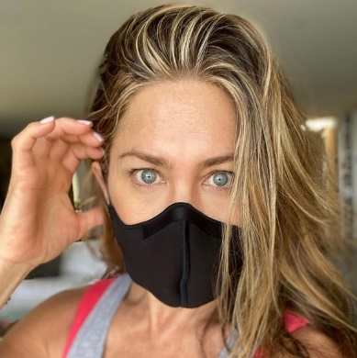
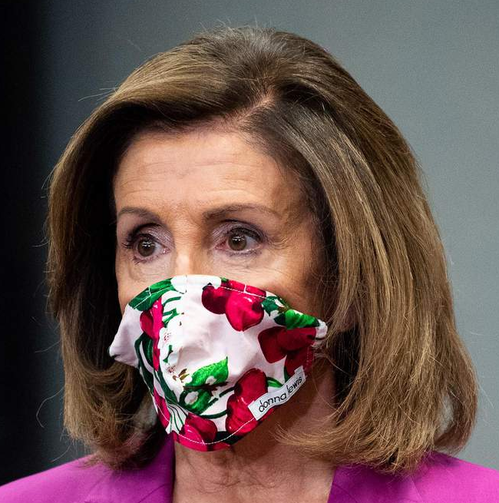



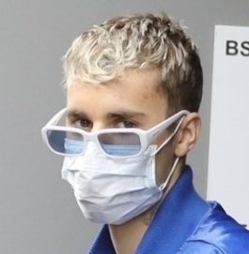
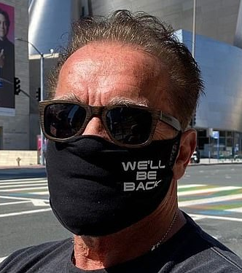
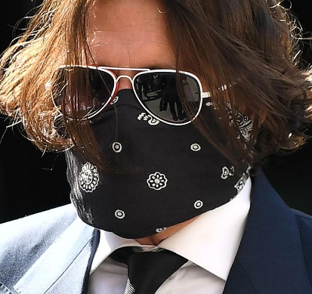
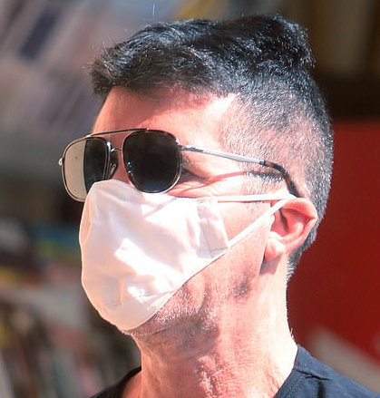

1.
2.
3.
4.
Introduction
Celebrities
Trivia
Spelling
High-Low
Chron-illogical
Wipeout
5.
6.
7.
8.
9.
10.
11.
12.

Slide 5
Celebrities Answers
Introduction
Celebrities
Trivia
Spelling
High-Low
Chron-illogical
Wipeout
Name the celebrity in these pictures from 2020
1 point for each
Questions: 12 Total Points: 12

Slide 6
1. Lorraine Kelly
2. Lady Gaga
3. Jennifer Aniston
4. Nancy Pelosi
Introduction
Celebrities
Trivia
Spelling
High-Low
Chron-illogical
Wipeout
5. Christine Lampard
6. Carole Baskin
7. Stephen Fry
8. Justin Bieber
9. Arnold Schwarzenegger
10. Johnny Depp
11. Simon Cowell
12. Keith Lemon
(Leigh Francis)

Slide 7
Trivia
Introduction
Celebrities
Trivia
Spelling
High-Low
Chron-illogical
Wipeout
1 point for the correct answer
Questions: 10 Total Points: 10

Slide 8
Trivia
Introduction
Celebrities
Trivia
Spelling
High-Low
Chron-illogical
Wipeout
A. White
1.
What colour are Daffy Duck’s feathers?
B. Black
C. Yellow

Slide 9
Trivia
Introduction
Celebrities
Trivia
Spelling
High-Low
Chron-illogical
Wipeout
A. Dragon
2.
What is Scotland’s national animal?
B. Pony
C. Unicorn

Slide 10
Trivia
Introduction
Celebrities
Trivia
Spelling
High-Low
Chron-illogical
Wipeout
A. Clive Staples
3.
What do the initials of the writer C.S. Lewis stand for?
B. Colin Salmon
C. Calamity Sam

Slide 11
Trivia
Introduction
Celebrities
Trivia
Spelling
High-Low
Chron-illogical
Wipeout
A. Jay
4.
What is Homer Simpson’s middle name?
B. James
C. Jebediah

Slide 12
Trivia
Introduction
Celebrities
Trivia
Spelling
High-Low
Chron-illogical
Wipeout
A. Play in bare feet
5.
In 1950, India withdrew from the World Cup because FIFA refused to let them do what?
B. Play in headwear
C. Play in black shirts

Slide 13
Trivia
Introduction
Celebrities
Trivia
Spelling
High-Low
Chron-illogical
Wipeout
A. Raven
6.
In Harry Potter, which animal is the house mascot of Hufflepuff?
B. Eagle
C. Badger

Slide 14
Trivia
Introduction
Celebrities
Trivia
Spelling
High-Low
Chron-illogical
Wipeout
A. Bear
7.
What is the real first name of Bear Grylls?
B. Edward
C. Rupert

Slide 15
Trivia
Introduction
Celebrities
Trivia
Spelling
High-Low
Chron-illogical
Wipeout
A. Stingray
8.
What type of creature is a sea wasp?
B. Jellyfish
C. Frog

Slide 16
Trivia
Introduction
Celebrities
Trivia
Spelling
High-Low
Chron-illogical
Wipeout
A. Sword
9.
Guinevere is the name of King Arthur’s what?
B. Horse
C. Wife

Slide 17
Trivia
Introduction
Celebrities
Trivia
Spelling
High-Low
Chron-illogical
Wipeout
A. Facebook
10.
Jack Dorsey founded which social network in 2006?
B. Twitter
C. Instagram

Slide 18
Trivia Answers
Introduction
Celebrities
Trivia
Spelling
High-Low
Chron-illogical
Wipeout
1 point for the correct answer
Questions: 10 Total Points: 10

Slide 19
Trivia Answers
Introduction
Celebrities
Trivia
Spelling
High-Low
Chron-illogical
Wipeout
1.
What colour are Daffy Duck’s feathers?
B. Black

Slide 20
Trivia Answers
Introduction
Celebrities
Trivia
Spelling
High-Low
Chron-illogical
Wipeout
2.
What is Scotland’s national animal?
C. Unicorn

Slide 21
Trivia Answers
Introduction
Celebrities
Trivia
Spelling
High-Low
Chron-illogical
Wipeout
A. Clive Staples
3.
What do the initials of the writer C.S. Lewis stand for?

Slide 22
Trivia Answers
Introduction
Celebrities
Trivia
Spelling
High-Low
Chron-illogical
Wipeout
A. Jay
4.
What is Homer Simpson’s middle name?

Slide 23
Trivia Answers
Introduction
Celebrities
Trivia
Spelling
High-Low
Chron-illogical
Wipeout
A. Play in bare feet
5.
In 1950, India withdrew from the World Cup because FIFA refused to let them do what?

Slide 24
Trivia Answers
Introduction
Celebrities
Trivia
Spelling
High-Low
Chron-illogical
Wipeout
6.
In Harry Potter, which animal is the house mascot of Hufflepuff?
C. Badger

Slide 25
Trivia Answers
Introduction
Celebrities
Trivia
Spelling
High-Low
Chron-illogical
Wipeout
7.
What is the real first name of Bear Grylls?
B. Edward

Slide 26
Trivia Answers
Introduction
Celebrities
Trivia
Spelling
High-Low
Chron-illogical
Wipeout
8.
What type of creature is a sea wasp?
B. Jellyfish

Slide 27
Trivia Answers
Introduction
Celebrities
Trivia
Spelling
High-Low
Chron-illogical
Wipeout
9.
Guinevere is the name of King Arthur’s what?
C. Wife

Slide 28
Trivia Answers
Introduction
Celebrities
Trivia
Spelling
High-Low
Chron-illogical
Wipeout
10.
Jack Dorsey founded which social network in 2006?
B. Twitter

Slide 29
Spelling
Introduction
Celebrities
Trivia
Spelling
High-Low
Chron-illogical
Wipeout
Answer the question and spell it correctly
1 point for correct answer
Questions: 8 Total Points: 8

Slide 30
Spelling
Introduction
Celebrities
Trivia
Spelling
High-Low
Chron-illogical
Wipeout
1.
Paul Robinson and Susan Kennedy are characters in which Australian TV soap?

Slide 31
Spelling
Introduction
Celebrities
Trivia
Spelling
High-Low
Chron-illogical
Wipeout
2.
The month of the year which has an extra day in a leap year

Slide 32
Spelling
Introduction
Celebrities
Trivia
Spelling
High-Low
Chron-illogical
Wipeout
3.
What does the R stand for in the musical genre R&B?

Slide 33
Spelling
Introduction
Celebrities
Trivia
Spelling
High-Low
Chron-illogical
Wipeout
4.
A space entirely devoid of matter and a common name for a household cleaning appliance

Slide 34
Spelling
Introduction
Celebrities
Trivia
Spelling
High-Low
Chron-illogical
Wipeout
5.
Method of avoiding detection by mimicking the surrounding environment, e.g. in armed forces uniform

Slide 35
Spelling
Introduction
Celebrities
Trivia
Spelling
High-Low
Chron-illogical
Wipeout
6.
A type of monarch in ancient Egypt – Moses pleaded with one to “let my people go”

Slide 36
Spelling
Introduction
Celebrities
Trivia
Spelling
High-Low
Chron-illogical
Wipeout
7.
Type of antibiotic first discovered by Alexander Fleming in 1928

Slide 37
Spelling
Introduction
Celebrities
Trivia
Spelling
High-Low
Chron-illogical
Wipeout
8.
A type of word that imitates the sound that it describes, e.g. “bang” or “crunch”

Slide 38
Spelling Answers
Introduction
Celebrities
Trivia
Spelling
High-Low
Chron-illogical
Wipeout
Answer the question and spell it correctly
1 point for correct answer
Questions: 8 Total Points: 8

Slide 39
Spelling Answers
Introduction
Celebrities
Trivia
Spelling
High-Low
Chron-illogical
Wipeout
1.
Paul Robinson and Susan Kennedy are characters in which Australian TV soap?
N E I G H B O U R S

Slide 40
Spelling Answers
Introduction
Celebrities
Trivia
Spelling
High-Low
Chron-illogical
Wipeout
2.
The month of the year which has an extra day in a leap year
F E B R U A R Y

Slide 41
Spelling Answers
Introduction
Celebrities
Trivia
Spelling
High-Low
Chron-illogical
Wipeout
3.
What does the R stand for in the musical genre R&B?
R H Y T H M

Slide 42
Spelling Answers
Introduction
Celebrities
Trivia
Spelling
High-Low
Chron-illogical
Wipeout
4.
A space entirely devoid of matter and a common name for a household cleaning appliance
V A C U U M

Slide 43
Spelling Answers
Introduction
Celebrities
Trivia
Spelling
High-Low
Chron-illogical
Wipeout
5.
Method of avoiding detection by mimicking the surrounding environment, e.g. in armed forces uniform
C A M O U F L A G E

Slide 44
Spelling Answers
Introduction
Celebrities
Trivia
Spelling
High-Low
Chron-illogical
Wipeout
6.
A type of monarch in ancient Egypt – Moses pleaded with one to “let my people go”
P H A R A O H

Slide 45
Spelling Answers
Introduction
Celebrities
Trivia
Spelling
High-Low
Chron-illogical
Wipeout
7.
Type of antibiotic first discovered by Alexander Fleming in 1928
P E N I C I L L I N

Slide 46
Spelling Answers
Introduction
Celebrities
Trivia
Spelling
High-Low
Chron-illogical
Wipeout
8.
A type of word that imitates the sound that it describes, e.g. “bang” or “crunch”
O N O M A T O P O E I A

Slide 47
Highbrow Lowbrow
Introduction
Celebrities
Trivia
Spelling
High-Low
Chron-illogical
Wipeout
2 points for the correct answer after first clue
1 point for the correct answer after the second clue
Questions: 5 Total Points: 10

Slide 48
Highbrow Lowbrow
Introduction
Celebrities
Trivia
Spelling
High-Low
Chron-illogical
Wipeout
1.
Common name for birds of the order Sphenisciformes
Write down an answer before you see the second clue for a chance of 2 points

Slide 49
Highbrow Lowbrow
Introduction
Celebrities
Trivia
Spelling
High-Low
Chron-illogical
Wipeout
1.
Common name for birds of the order Sphenisciformes
The answer will be shown next so make sure you have something written down
A chocolate covered biscuit bar you might
p…p…p…pick up

Slide 50
Highbrow Lowbrow
Introduction
Celebrities
Trivia
Spelling
High-Low
Chron-illogical
Wipeout
1.
Common name for birds of the order Sphenisciformes
Penguin
A chocolate covered biscuit bar you might
p…p…p…pick up

Slide 51
Highbrow Lowbrow
Introduction
Celebrities
Trivia
Spelling
High-Low
Chron-illogical
Wipeout
2.
Metallic element always present in an amalgum
Write down an answer before you see the second clue for a chance of 2 points

Slide 52
Highbrow Lowbrow
Introduction
Celebrities
Trivia
Spelling
High-Low
Chron-illogical
Wipeout
2.
Metallic element always present in an amalgum
The answer will be shown next so make sure you have something written down
Stage surname of singer born Farrokh Bulsara

Slide 53
Highbrow Lowbrow
Introduction
Celebrities
Trivia
Spelling
High-Low
Chron-illogical
Wipeout
2.
Metallic element always present in an amalgum
Mercury
Stage surname of singer born Farrokh Bulsara

Slide 54
Highbrow Lowbrow
Introduction
Celebrities
Trivia
Spelling
High-Low
Chron-illogical
Wipeout
3.
Metallic element with the highest electrical conductivity
Write down an answer before you see the second clue for a chance of 2 points

Slide 55
Highbrow Lowbrow
Introduction
Celebrities
Trivia
Spelling
High-Low
Chron-illogical
Wipeout
3.
Metallic element with the highest electrical conductivity
The answer will be shown next so make sure you have something written down
Name of the Lone Ranger’s horse

Slide 56
Highbrow Lowbrow
Introduction
Celebrities
Trivia
Spelling
High-Low
Chron-illogical
Wipeout
3.
Metallic element with the highest electrical conductivity
Silver
Name of the Lone Ranger’s horse

Slide 57
Highbrow Lowbrow
Introduction
Celebrities
Trivia
Spelling
High-Low
Chron-illogical
Wipeout
4.
American media organisation that posts free online talks under the slogan “ideas worth spreading”
Write down an answer before you see the second clue for a chance of 2 points

Slide 58
Highbrow Lowbrow
Introduction
Celebrities
Trivia
Spelling
High-Low
Chron-illogical
Wipeout
4.
American media organisation that posts free online talks under the slogan “ideas worth spreading”
The answer will be shown next so make sure you have something written down
2012 film starring Mark Wahlberg and the voice of
Seth Macfarlane

Slide 59
Highbrow Lowbrow
Introduction
Celebrities
Trivia
Spelling
High-Low
Chron-illogical
Wipeout
4.
American media organisation that posts free online talks under the slogan “ideas worth spreading”
Ted
2012 film starring Mark Wahlberg and the voice of
Seth Macfarlane

Slide 60
Chron-illogical
Introduction
Celebrities
Trivia
Spelling
High-Low
Chron-illogical
Wipeout
Sort the 3 clues into chronological order
2 points for the correct answer, e.g. C B A
Questions: 6 Total Points: 12

Slide 61
Chron-illogical
Introduction
Celebrities
Trivia
Spelling
High-Low
Chron-illogical
Wipeout
1.
A
B
C
Collapse of the Berlin Wall
Falklands War
Mandela becomes president of South Africa

Slide 62
Chron-illogical
Introduction
Celebrities
Trivia
Spelling
High-Low
Chron-illogical
Wipeout
2.
A
B
C
The Black Death arrived in England
Darwin’s “On the Origin of Species”
is published
Last known sighting of the dodo bird

Slide 63
Chron-illogical
Introduction
Celebrities
Trivia
Spelling
High-Low
Chron-illogical
Wipeout
3.
A
B
C
Japanese attack Pearl Harbor
Marie Curie
becomes the first woman to win a Nobel Prize
Sinking of the Titanic

Slide 64
Chron-illogical
Introduction
Celebrities
Trivia
Spelling
High-Low
Chron-illogical
Wipeout
4.
A
B
C
Start of the Great Fire of London
The Spanish Armada sets sail for England
Declaration of American Independence

Slide 65
Chron-illogical
Introduction
Celebrities
Trivia
Spelling
High-Low
Chron-illogical
Wipeout
5.
A
B
C
Assassination of President Kennedy
Man first lands on the moon
Sir Edmund Hillary reaches the summit of Mt. Everest

Slide 66
Chron-illogical
Introduction
Celebrities
Trivia
Spelling
High-Low
Chron-illogical
Wipeout
6.
A
B
C
Good Friday Agreement signed in Northern Ireland
Chernobyl
nuclear disaster
Margaret Thatcher becomes Prime Minister

Slide 67
Chron-illogical Answers
Introduction
Celebrities
Trivia
Spelling
High-Low
Chron-illogical
Wipeout
Sort the 3 clues into chronological order
2 points for the correct answer, e.g. C B A
Questions: 6 Total Points: 12

Slide 68
Chron-illogical Answers
Introduction
Celebrities
Trivia
Spelling
High-Low
Chron-illogical
Wipeout
1.
B
A
C
Falklands War
Collapse of the Berlin Wall
Mandela becomes president of South Africa
1982
1989
1994

Slide 69
Chron-illogical Answers
Introduction
Celebrities
Trivia
Spelling
High-Low
Chron-illogical
Wipeout
2.
A
C
B
The Black Death arrived in England
Last known sighting of the dodo bird
Darwin’s “On the Origin of Species”
is published
1348
1662
1859

Slide 70
Chron-illogical Answers
Introduction
Celebrities
Trivia
Spelling
High-Low
Chron-illogical
Wipeout
3.
B
C
A
Marie Curie
becomes the first woman to win a Nobel Prize
Sinking of the Titanic
Japanese attack Pearl Harbor
1903
1912
1941

Slide 71
Chron-illogical Answers
Introduction
Celebrities
Trivia
Spelling
High-Low
Chron-illogical
Wipeout
4.
B
A
C
The Spanish Armada sets sail for England
Start of the Great Fire of London
Declaration of American Independence
1588
1666
1776

Slide 72
Chron-illogical Answers
Introduction
Celebrities
Trivia
Spelling
High-Low
Chron-illogical
Wipeout
5.
C
A
B
Sir Edmund Hillary reaches the summit of Mt. Everest
Assassination of President Kennedy
Man first lands on the moon
1953
1963
1969

Slide 73
Chron-illogical Answers
Introduction
Celebrities
Trivia
Spelling
High-Low
Chron-illogical
Wipeout
6.
C
B
A
Margaret Thatcher becomes Prime Minister
Chernobyl
nuclear disaster
Good Friday Agreement signed in Northern Ireland
1979
1986
1998

Slide 74
Wipeout
Introduction
Celebrities
Trivia
Spelling
High-Low
Chron-illogical
Wipeout
Write down one answer to the category
2 points if answer is correct and unique (no one else wrote it down)
Questions: 5 Total Points: 10

Slide 75
Wipeout
Introduction
Celebrities
Trivia
Spelling
High-Low
Chron-illogical
Wipeout
1.
First Name of Strictly winning professional dancer up to series 17

Slide 76
Wipeout
Introduction
Celebrities
Trivia
Spelling
High-Low
Chron-illogical
Wipeout
1.
First Name of Strictly winning professional dancer up to series 17
Time’s up!
Each player/team should now reveal their answer to the group
Any duplicates score zero points
Correct answers shown next…

Slide 77
Wipeout
Introduction
Celebrities
Trivia
Spelling
High-Low
Chron-illogical
Wipeout
1.
First Name of Strictly winning professional dancer up to series 17
Aliona
Aljaž
Artem
Brendan
Camilla
Darren
Flavia
Joanne
Karen
Katya
Kevin
Lilia
Matthew
Ola
Oti
Pasha
2 points if answer is correct and unique

Slide 78
Wipeout
Introduction
Celebrities
Trivia
Spelling
High-Low
Chron-illogical
Wipeout
2.
First name of a character to appear in every season of Modern Family

Slide 79
Wipeout
Introduction
Celebrities
Trivia
Spelling
High-Low
Chron-illogical
Wipeout
2.
First name of a character to appear in every season of Modern Family
Time’s up!
Each player/team should now reveal their answer to the group
Any duplicates score zero points
Correct answers shown next…

Slide 80
Wipeout
Introduction
Celebrities
Trivia
Spelling
High-Low
Chron-illogical
Wipeout
2.
First name of a character to appear in every season of Modern Family
Alex
Cameron
Claire
Dylan
Gloria
Haley
Jay
Lily
Luke
Manny
Mitchell
Phil
2 points if answer is correct and unique

Slide 81
Wipeout
Introduction
Celebrities
Trivia
Spelling
High-Low
Chron-illogical
Wipeout
3.
Actors to have played either Q or M in a James Bond film

Slide 82
Wipeout
Introduction
Celebrities
Trivia
Spelling
High-Low
Chron-illogical
Wipeout
3.
Actors to have played either Q or M in a James Bond film
Time’s up!
Each player/team should now reveal their answer to the group
Any duplicates score zero points
Correct answers shown next…

Slide 83
Wipeout
Introduction
Celebrities
Trivia
Spelling
High-Low
Chron-illogical
Wipeout
3.
Actors to have played either Q or M in a James Bond film
Alec McCowen
Ben Whishaw
Bernard Lee
David Niven
Desmond Llewelyn
Edward Fox
Geoffrey Bayldon
John Cleese
John Huston
Judi Dench
Peter Burton
Ralph Fiennes
Robert Brown
2 points if answer is correct and unique

Slide 84
Thanks for playing!

